Slide 1
Cryptography during the Revolution
Cyber Security First Principle Information Hiding

Slide 2
The Lesson
During this lesson students will learn why Washington used cryptography during the Revolutionary War. Students will learn about the Culper Cipher that Washington’s Spy Ring developed. The Student’s will be taught the keyword Cipher and will have students work a cipher with teach. After teaching the keyword cypher students will develop their own keyword cipher message and will submit to teacher.

Slide 3
History of Ciphers
Add several slides about cypher throughout time.

Slide 4
Culper video Preview
https://www.youtube.com/watch?v=wlfuI69Tf5A

Slide 5
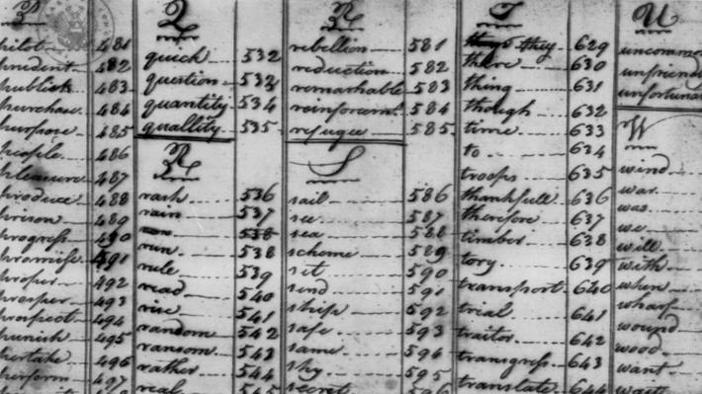
Portion of Culper Cipher

Slide 6
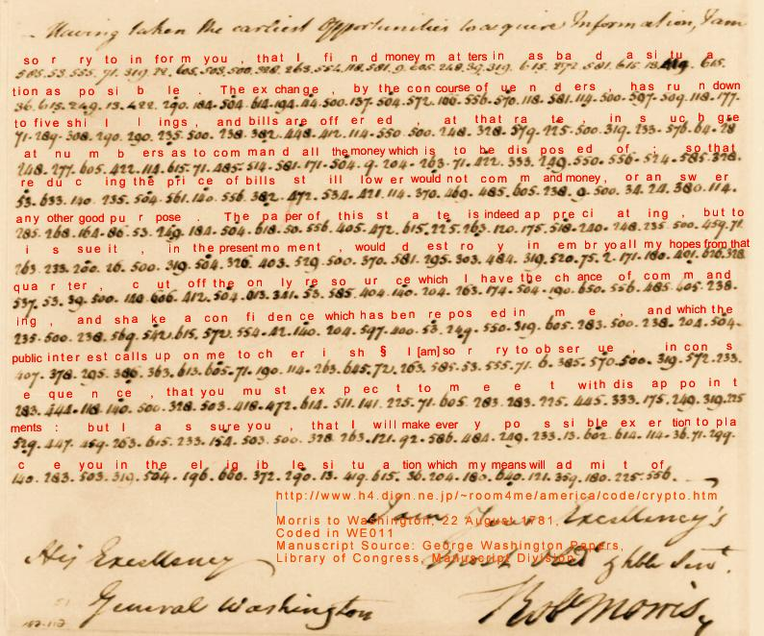
Message translated using culper cypher
Note that each word
Is represented by
number.

Slide 7
The Project
After completion of demonstrating the Keyword Cipher the students will develop their own Keyword Cipher and sent the teacher a cryptic message with their Keyword.

