Slide 1
Cybersecurity: Risk Management
Janica Edmonds
Notes:
http://www.pbs.org/wgbh/nova/labs/video_popup/5/34/

Slide 2
Cyber Realm
Card game
Created by GenCyber Duo at California State University, San Bernardino
Answers??

Slide 3
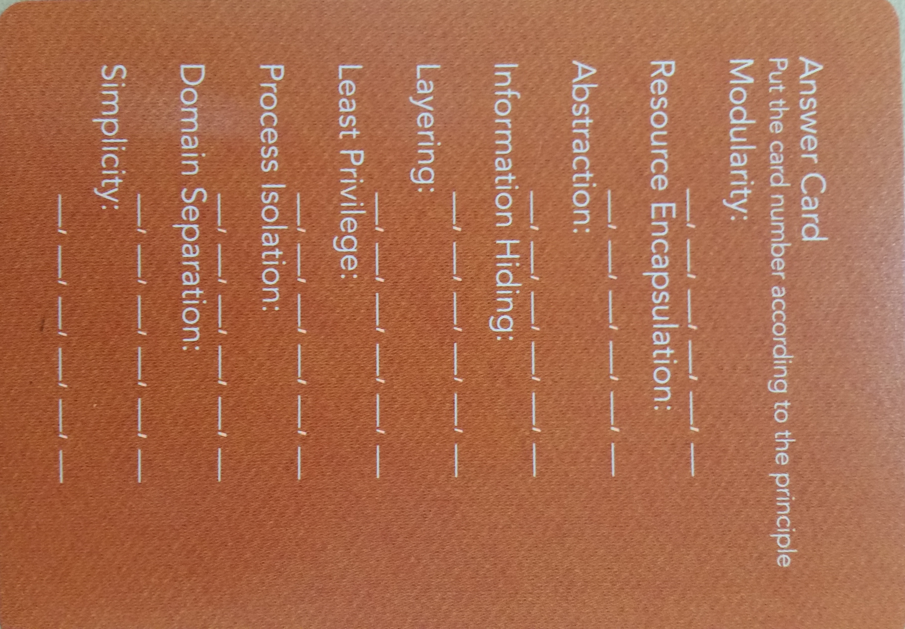
Answers
Minimization
40
27
28
30
4
10
18
35
23
24
25
32
6
14
20
38
3
8
12
37
7
17
26
34
1
5
9
15
36
2
19
22
31
9
16
21
39
11
13
29
33
Notes:
Notes: #9 shows up in two places
Minimization was left off the card (see top for solutions)

Slide 4
Example: Mom & Pop Shop
Mom & Pop Shop
Running a touristy type business selling handmade crafts
Keep accounts and business transactions records on a computer
Running a website to advertise their business

Slide 5
Example: Threat Matrix
Mom & Pop Shop
Threat/Asset | HW | SW | People | Data
Interception
Interruption
Modification
Fabrication
Notes:
What are some things that could happen to threaten the security of the Mom & Pop Shop?
Form small groups of three or four
Brainstorm ways of filling in the possible threats to the security of the Mom & Pop Shop
10 minutes or so
Reconvene for discussion

Slide 6
Example: Application of Principles
Domain separation
Layering
Least privilege
Information hiding
Simplicity
Minimization
Modularization
Notes:
Domain separation – keep website hosting separate from accounting records
Layering – levels of security
Least privilege – who has access? To what?
Information hiding – keeping account #s, etc. hidden.
Simplicity –
Minimization – least functionality needed → no online purchases? No need for certain SW
Modularization – let’s add functionality → online purchases! How does that change the threat matrix?

Slide 7
Risk Management
Risk assessment
Identify and evaluate risk, its impact, and recommended risk reducing activities
Risk mitigation
Prioritize, implement, and maintain risk reducing activities
Evaluation
Continual process

Slide 8
Risk Mitigation
Prioritize, evaluate, and implement controls
Philosophy
Risk mitigation options
Notes:
Philosophy
Least cost approach
Implement most appropriate controls
Accept minimal adverse impact
Risk mitigation options
Risk assumption – zen-like state
risk avoidance – e.g., shut down services to avoid attacks
risk limitation – implement controls to mitigate threats
risk planning – managing risk systematically
Research and acknowledgement – identify flaws and correct them
Risk transference – e.g., insurance

Slide 9
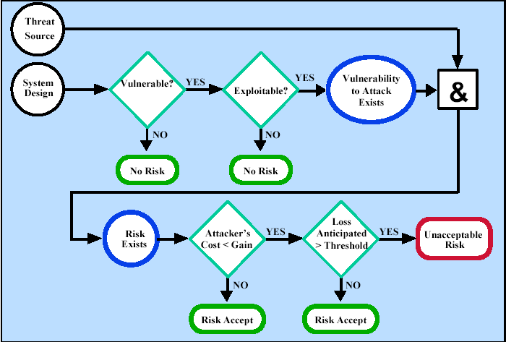
Risk Mitigation: Action Points
Notes:
Action point rules of thumb
Vulnerability exists? Implement assurance techniques to reduce likelihood of exercise
Vulnerability can be exercised? Apply layered protection to minimize impact
Attacker’s cost < potential gain? Apply protection to decrease attacker incentive
Loss is too great? Apply design principles and protective measures to reduce the potential for loss

Slide 10
Security Controls
Prevent, limit, deter threat-source damage to assets
Technical
Management
Operational

Slide 11
Technical Controls
Supporting
Preventive
Detect and recover
Notes:
Supporting
Underlie most security capabilities
Preventive
E.g., firewalls, access control, secure communication
Detect and recover
Auditing, redundancy, archival, IDSs

Slide 12
Management Controls
Information protection policies, guidelines & standards for operations
Preventive
Detection
Recovery
Notes:
Preventive
Assign security responsibility
Develop and maintain security plans
Implement personnel security controls such as least privilege or separation of duties
Conduct security awareness & training
Detection
Implement personnel security controls such as background checks
Periodic review of security controls
Periodic system audits
Ongoing risk management processes
Recovery
Provide for continuity of operations during emergencies and disasters
Establish an incident response capability

Slide 13
Operational Controls
Procedures governing the use and operation of IT systems
Preventive
Detection
Notes:
Preventive
Control data media access and disposal
Limit external data distribution
Control SW viruses
Protect computing facility (badges, biometrics, guards)
Provide backup capability (power, communications, and facility)
Control environment (temperature, humidity)
Detection
Provide physical security (cameras)
Monitor environmental conditions (smoke/fire detectors)

Slide 14
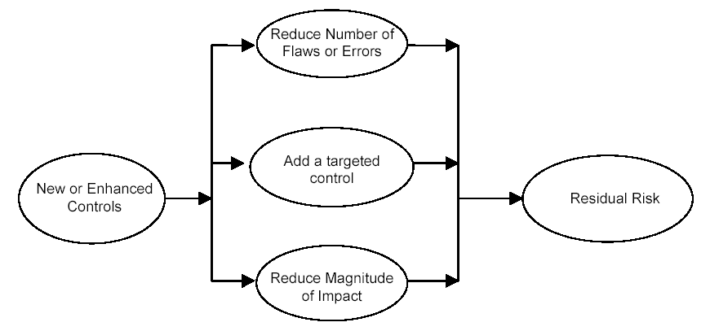
Residual Risk

